Slide 1


Data Analysis

Slide 2


Today's agenda
Project recap
Problem
The Analytics team
Process
Insights
Summary

Slide 3

Social Buzz, a rapidly growing technology unicorn, has scaled quicker than anticipated and need the help of an advisory firm to oversee their scaling process effectively.
Accenture has begun a 3-month POC focusing on the following tasks:
An audit of Social Buzz’s social practice
Recommendations for a successful IPO
An analysis on their content categories that highlights the top 5 categories with the largest aggregate popularity.
Project Recap

Slide 4


Problem
Over 100,000 pieces of content a day are posted
That is more than 36 M pieces of content a year
But how to capitalize on it when there is so much?
Analysis to find Social Buzz’s top most popular categories of content!

Slide 5



The
Analytics Team

Slide 6
Process
1
Data Understanding
2
Data Cleaning
3
Data Modelling
4
Data Analysis
5
Uncover insights

Slide 7

Insights
16
UNIQUE CATEGORIES
1897
ANIMAL POSTS
JANUARY
MOST POPULAR MONTH
Notes:
There are 16 unique categories
The top five categories are animals, science, healthy eating, food, and technology. In that order.
The category ‘animals’ is the most popular, with a frequency of 1897, being the 7,72% of total posts.
The most popular month was January.
The most popular type of content is photo, followed by video, GIF, and finally audio. However, the 4 categories are even.

Slide 8
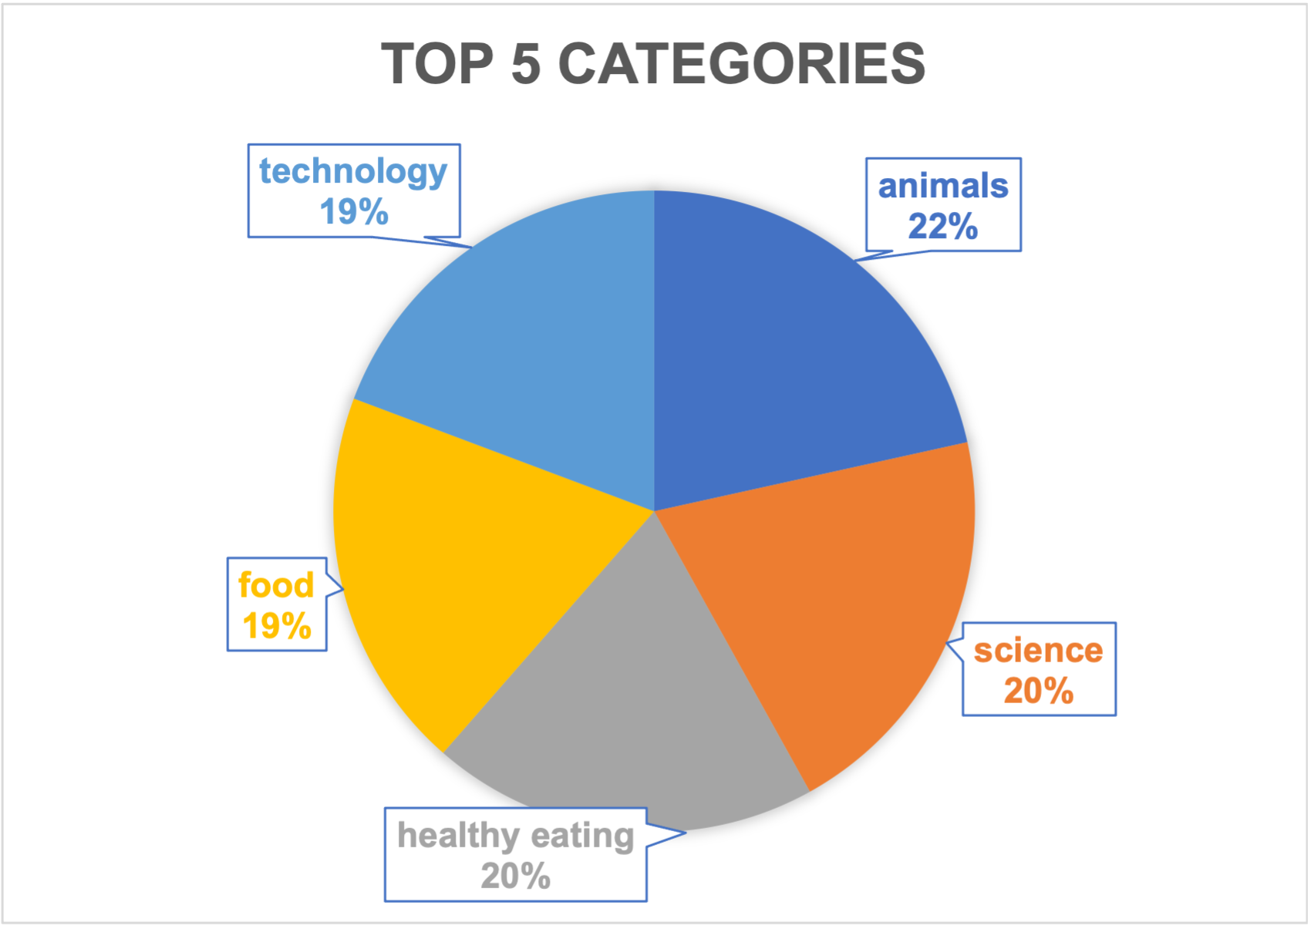

Slide 9
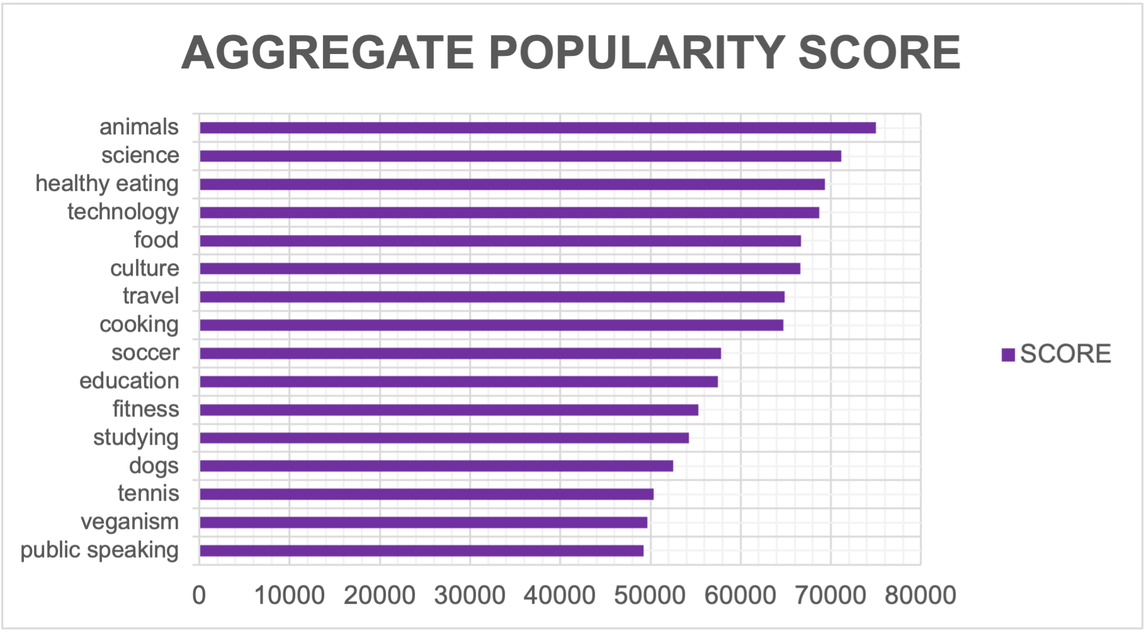

Slide 10
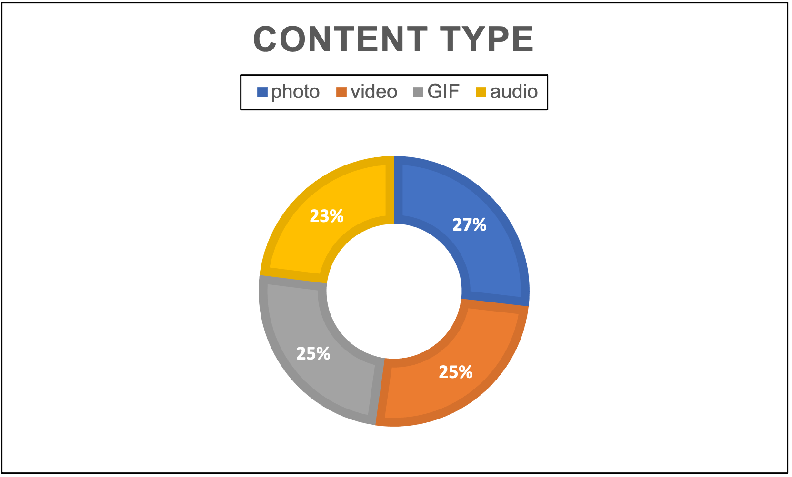

Slide 11
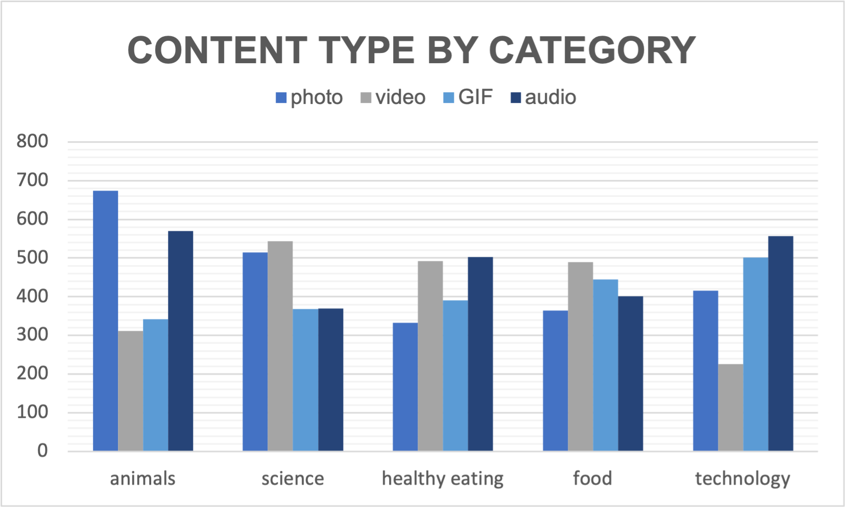

Slide 12

Summary
A more in depth analysis with more data will leed to useful insights in

Slide 13

Thank you!
ANY QUESTIONS?

